Slide 1
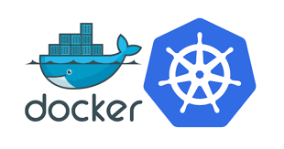
Docker Containers and Kubernetes Fundamentals

Slide 2
Expectations
Covers the fundamentals
Understand the benefits of using containers and Kubernetes
Hands-on! Learning by coding, deploying and managing
Use docker and Kubernetes locally. No need to have an account with a Cloud provider

Slide 3
Course Content
Introduction to Containers
Container Concepts
What is Docker?
Docker Hands-On
Basic Commands
Basic Commands Hands-On
Running Containers
Running Containers Hands-On
Building Containers
Building Containers Hands-On
Persisting Data
Containers are Ephemerous and Stateless
Docker Volumes Concepts
Using Docker Volumes Hands-On

Slide 4
Course Content
Container Registries
Container Registries Concepts
Push/Pull Images from Docker Hub
Push/Pull Images from Docker Hub Hands-On
Kubernetes Concepts
Kubernetes Concepts
Kubernetes API
Using Kubectl Hands-On
The Declarative Way vs the Imperative Way
The Imperative Way Hands-On
Namespaces
Namespaces Concepts
Namespaces Hands-On

Slide 5
Course Content
Nodes
Master Node Concepts
Worker Nodes Concepts
Nodes Hands-On
Pods
Pod Concepts
The Pod Lifecycle
Defining and Running Pods
Pod Hands-On
Init Containers
Init Containers Hands-On
Selectors
Selector Concepts
Selector Hands-On

Slide 6
Course Content
Multi Container Pods
Common Patterns for Running More then One Container in a Pod
Multi Container Pods Networking Concepts
Multi Containers Pods Hands-On
Workloads
Introduction to Workloads
ReplicaSet Concepts
ReplicaSet Hands-On
Deployment Concepts
Deployment Hands-On
DaemonSet Concepts
DaemonSet Hands-On
Job Concepts
Job Hands-On
CronJob Concepts
CronJob Hands-On
Updates
Rolling Updates Concepts
Rolling Updates Hands-On

Slide 7
Course Content
Services
What are services?
ClusterIP Concepts
ClusterIP Hands-On
NodePort Concepts
NodePort Hands-On
Load Balancer Concepts
Load Balancer on Docker Desktop Hands-On
Storage & Persistence
Storage & Persistence Concepts
The Static Way
The Static Way Hands-On
The Dynamic Way
Application Settings
ConfigMaps Concepts
ConfigMaps Hands-On
Secrets Concepts
Secrets Hands-On

Slide 8
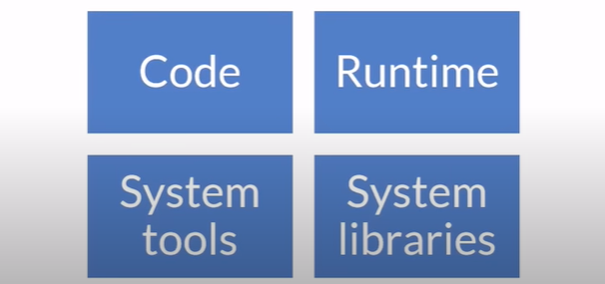
Introduction to Containers - Container Concepts
What is a container?

Slide 9
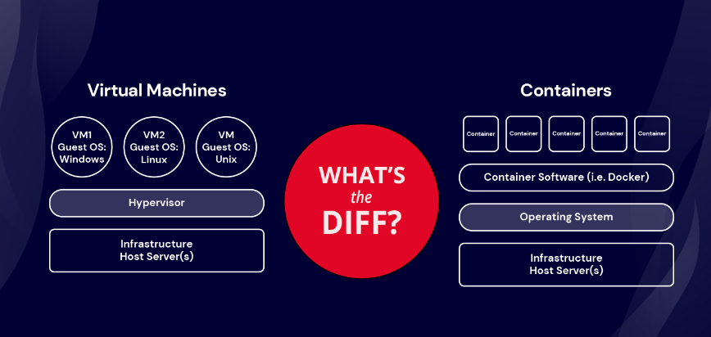
Introduction to Containers - Container Concepts

Slide 10
Introduction to Containers - What is Docker?
Docker is an open platform for developing, shipping, and running applications.

Slide 11
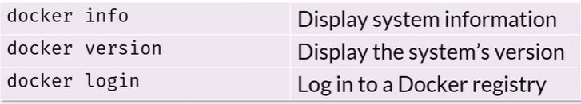
Introduction to Containers - Basic Commands
Docker CLI Cheat Sheet – Management

Slide 12
Introduction to Containers - Basic Commands Hands-On

Slide 13
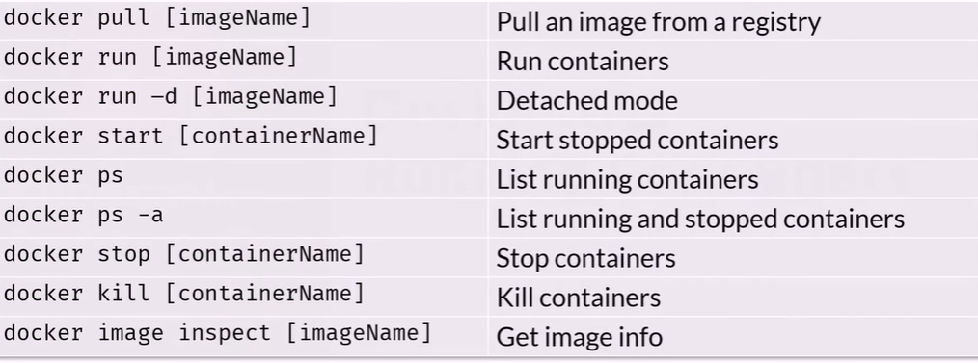
Introduction to Containers - Running Containers
Docker CLI Cheat Sheet – Running and stopping

Slide 14
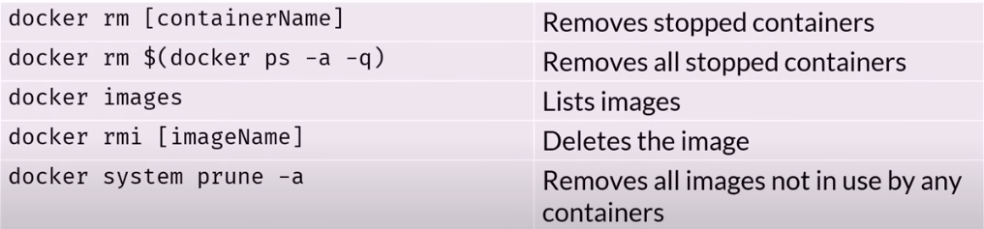
Introduction to Containers - Running Containers
Docker CLI Cheat Sheet – Cleaning up

Slide 15
Introduction to Containers - Running Containers Hands-On

Slide 16
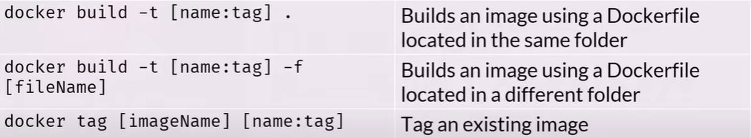
Introduction to Containers - Building Containers
Docker CLI Cheat Sheet – Building

Slide 17
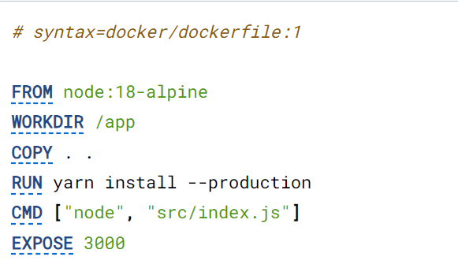
Introduction to Containers - Building Containers

Slide 18
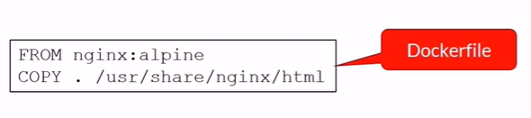
Introduction to Containers - Building Containers
Dockerfile - static HTML site

Slide 19
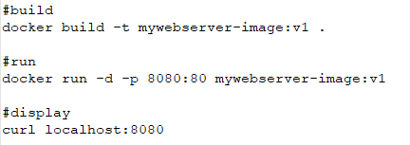
Introduction to Containers - Building Containers
Dockerfile - static HTML site

Slide 20
Introduction to Containers - Building Containers Hands-On

Slide 21
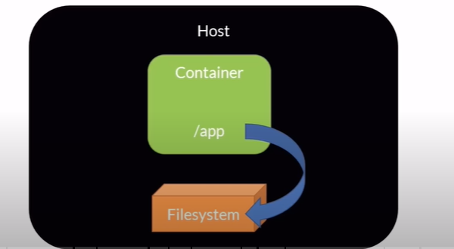
Persisting Data - Docker Volumes Concepts

Slide 22
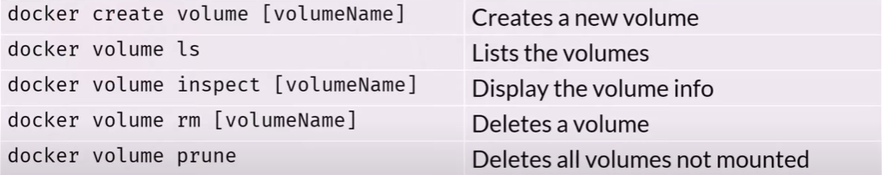
Persisting Data - Docker Volumes Concepts
Volume Cheat Sheet

Slide 23
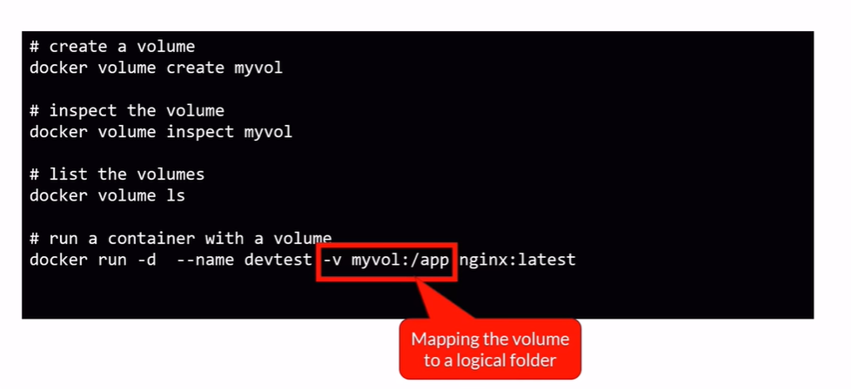
Persisting Data - Docker Volumes Concepts
Mapping a volume

Slide 24
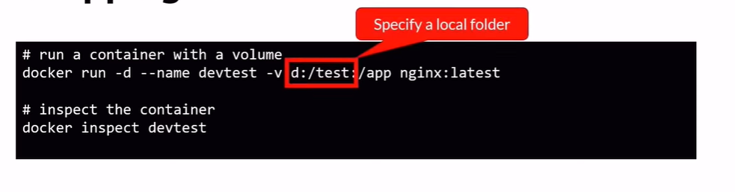
Persisting Data - Docker Volumes Concepts
Mapping to a local folder

Slide 25
Persisting Data - Using Docker Volumes Hands-On

Slide 26
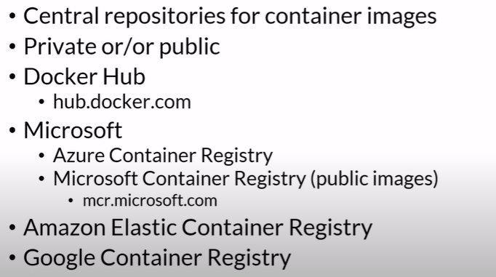
Container Registres - Container Registres Concepts

Slide 27
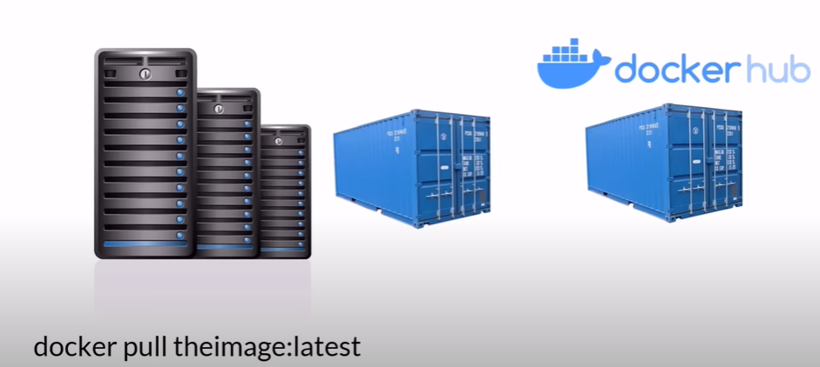
Container Registres - Container Registres Concepts

Slide 28
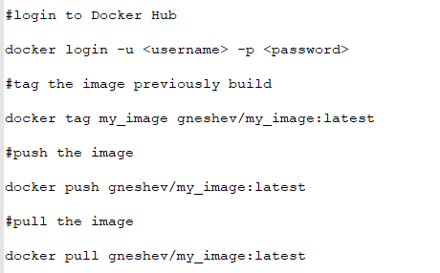
Container Registries - Push/Pull Images from Docker Hub

Slide 29
Container Registries - Push/Pull Images from Docker Hub Hands-On

Slide 30
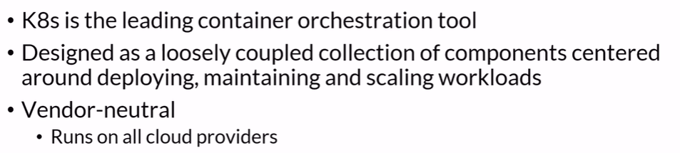
Kubernetes Concepts - Kubernetes Concepts

Slide 31
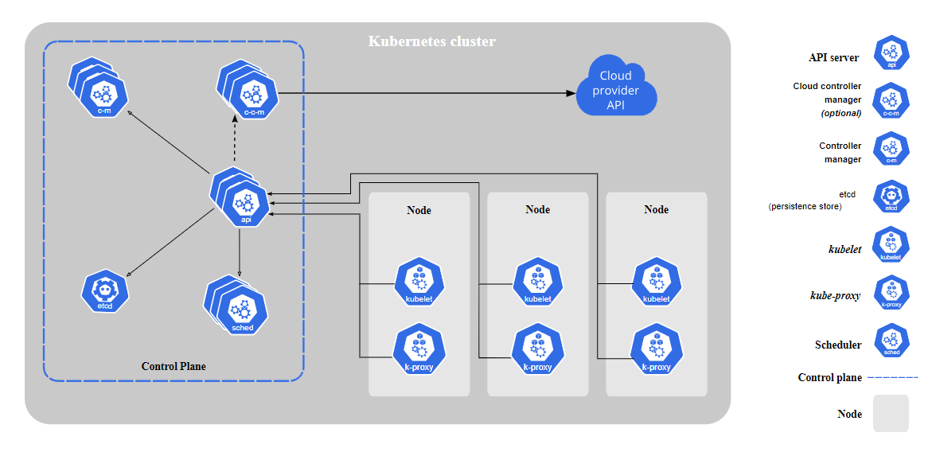
Kubernetes Concepts - Kubernetes Concepts

Slide 32
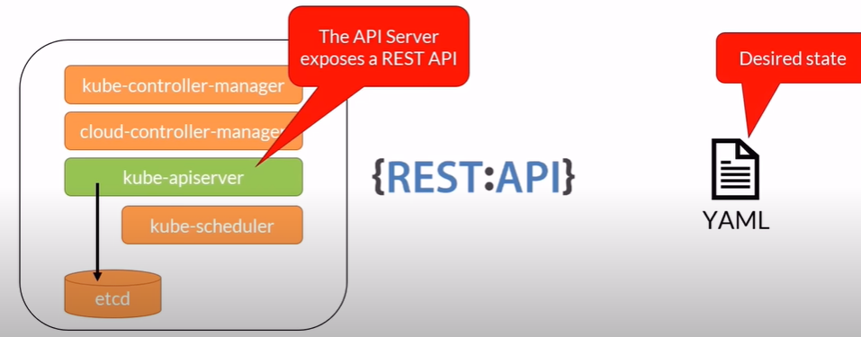
Kubernetes Concepts - Kubernetes API
K8s API

Slide 33
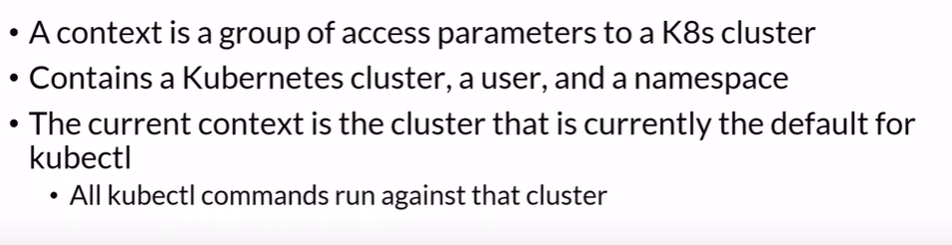
Kubernetes Concepts - Kubernetes API
K8s Context

Slide 34
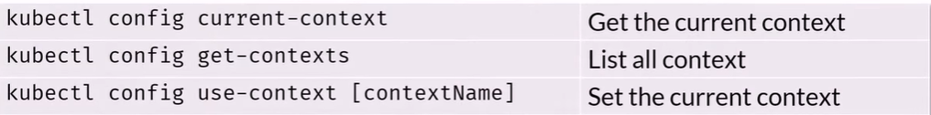
Kubernetes Concepts - Kubernetes API
Kubectl – Context Cheat Sheet

Slide 35
Kubernetes Concepts - Using Kubectl Hands-On

Slide 36
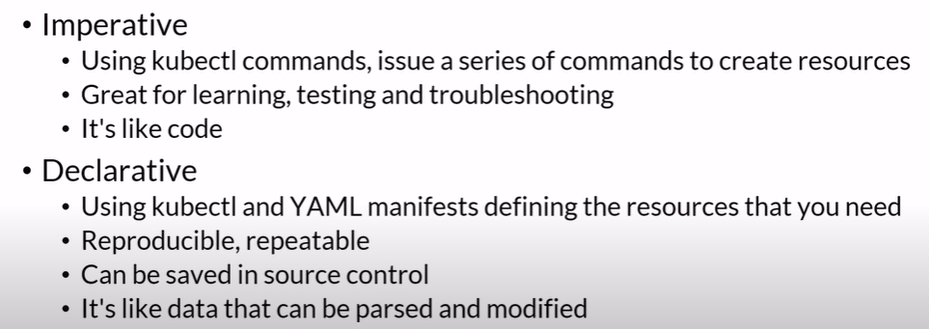
Kubernetes Concepts - The Declarative Way vs the Imperative Way
The Declarative way vs the imperative way

Slide 37
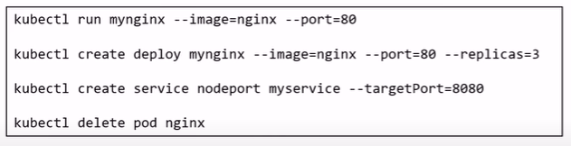
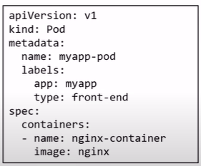
Kubernetes Concepts - The Declarative Way vs the Imperative Way
Series of command
YAML file

Slide 38
Kubernetes Concepts - The Imperative Way Hands-On

Slide 39
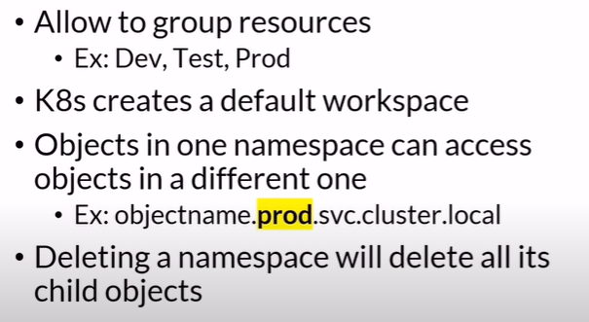
Namespaces - Namespaces Concepts
Namespace

Slide 40
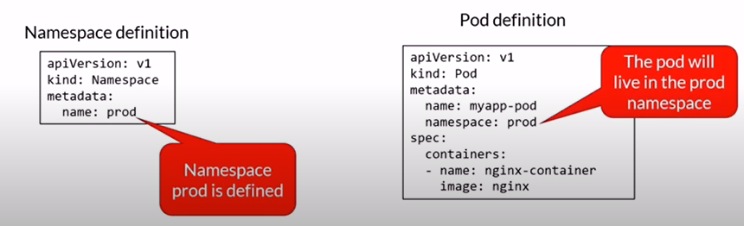
Namespaces - Namespaces Concepts
Namespace

Slide 41
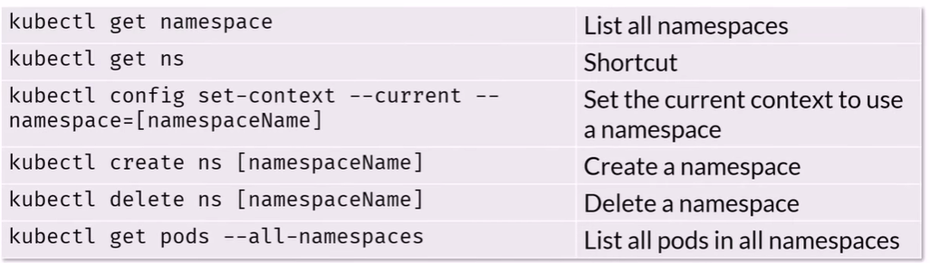
Namespaces - Namespaces Concepts
Kubectl – Namespace Cheat Sheet

Slide 42
Namespaces - Namespaces Hands-On

Slide 43
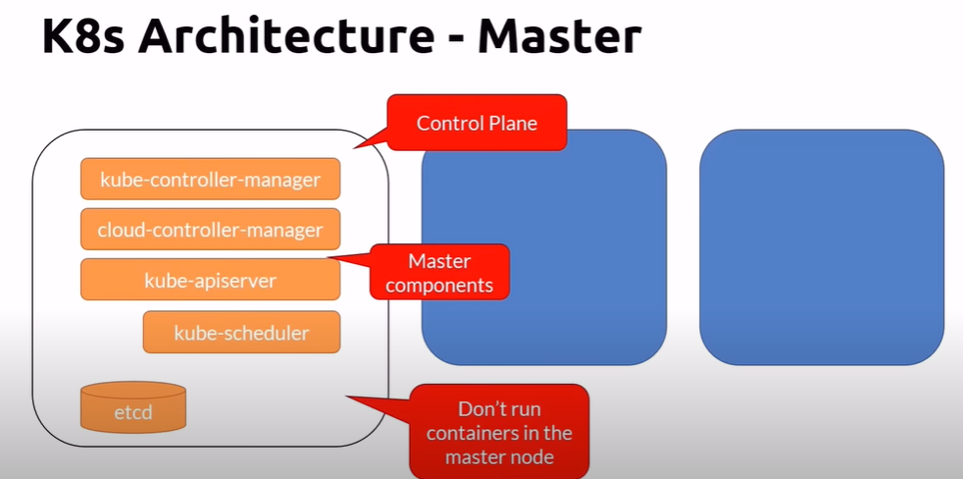
Nodes - Master Node Concepts

Slide 44
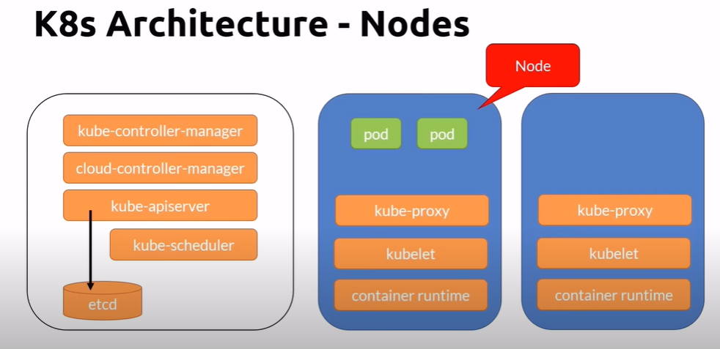
Nodes - Worker Nodes Concepts

Slide 45
Nodes - Nodes Hands-On

Slide 46
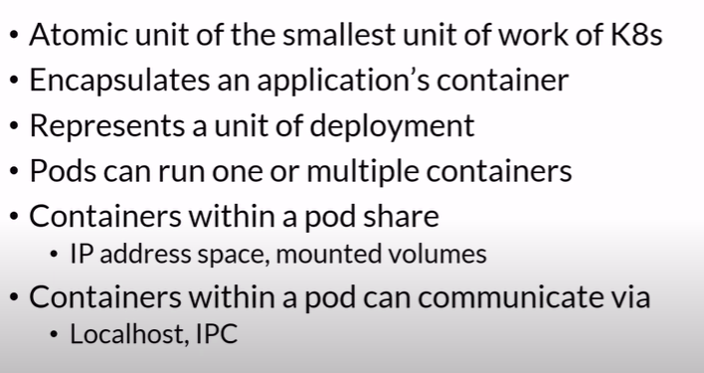
Pods - Pod Concepts

Slide 47
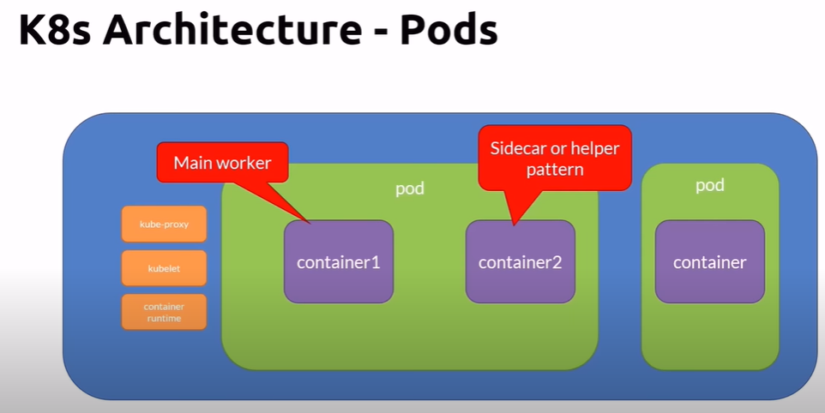
Pods - Pod Concepts

Slide 48
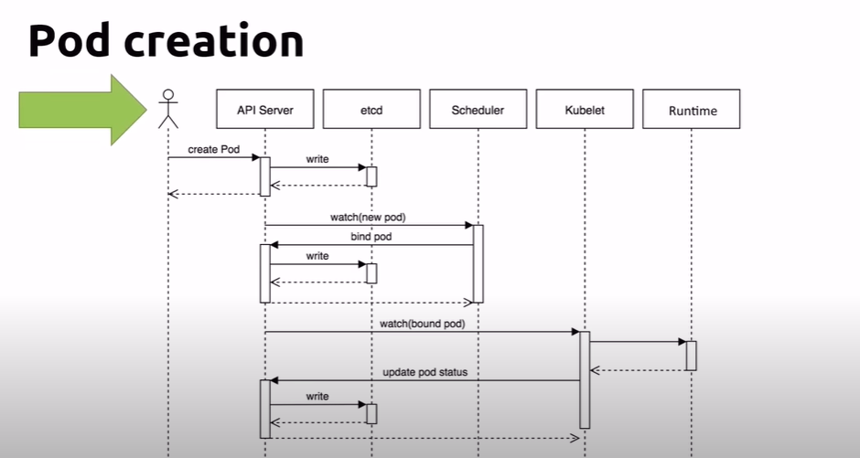
Pods - The Pod Lifecycle
Pod lifecycle

Slide 49
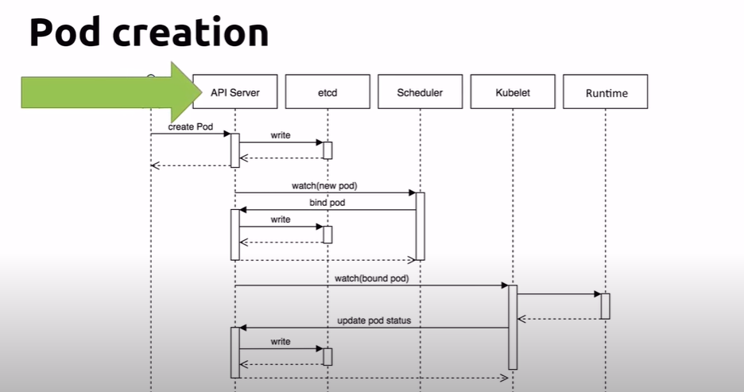
Pods - The Pod Lifecycle
Pod lifecycle

Slide 50
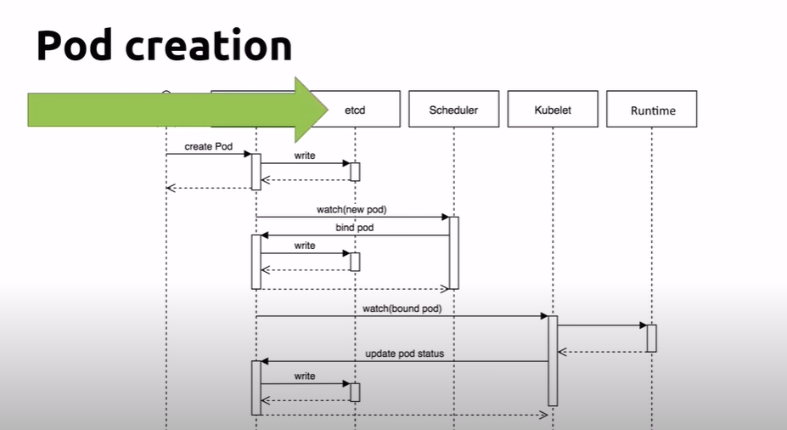
Pods - The Pod Lifecycle
Pod lifecycle

Slide 51
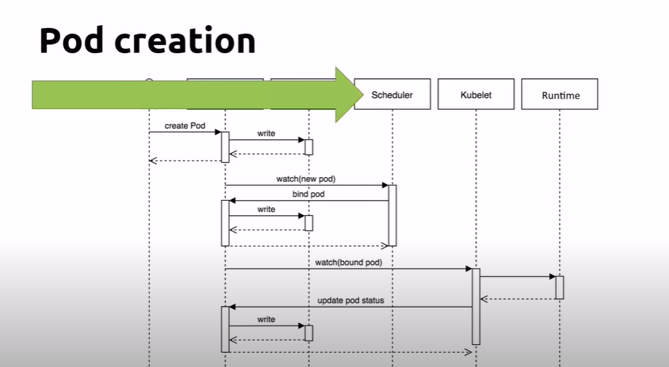
Pods - The Pod Lifecycle
Pod lifecycle

Slide 52
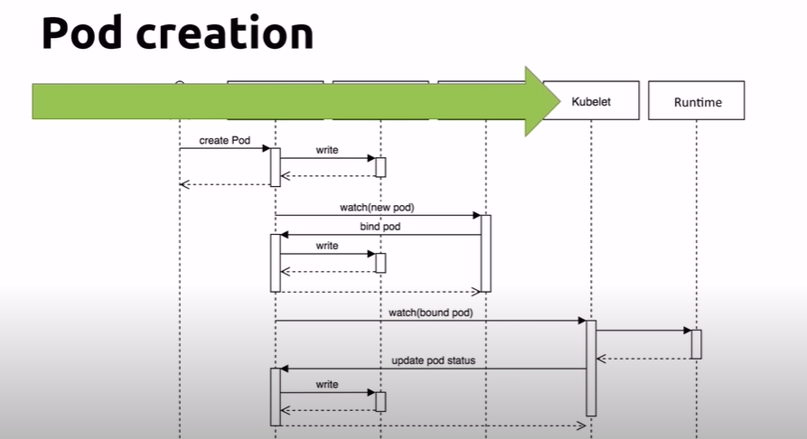
Pods - The Pod Lifecycle
Pod lifecycle

Slide 53
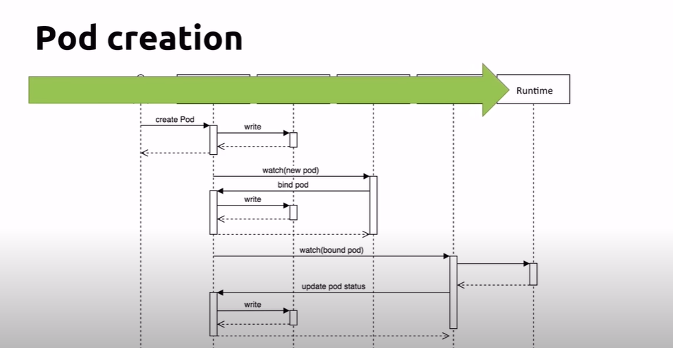
Pods - The Pod Lifecycle
Pod lifecycle

Slide 54
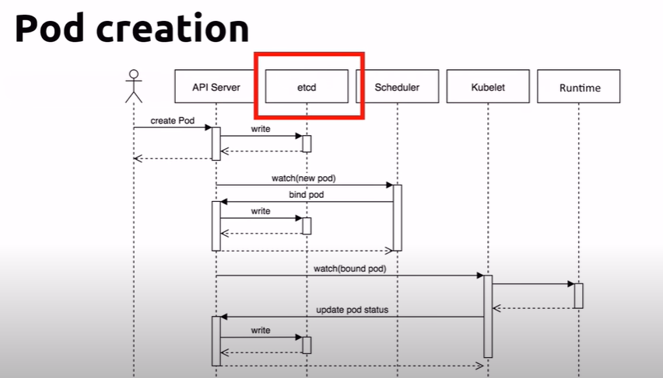
Pods - The Pod Lifecycle
Pod lifecycle

Slide 55
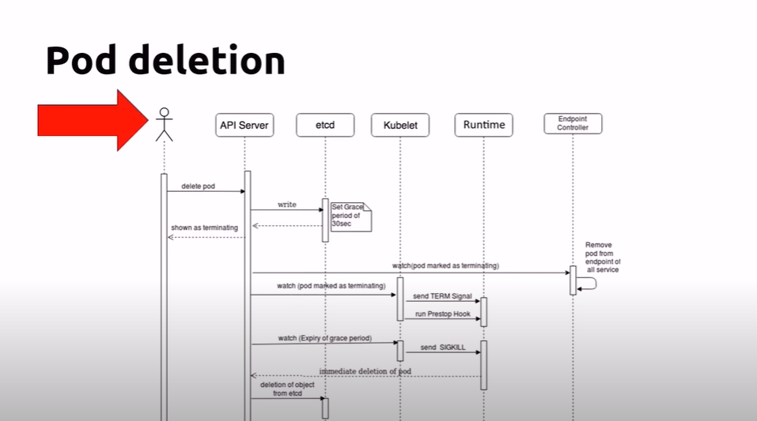
Pods - The Pod Lifecycle
Pod deletion

Slide 56
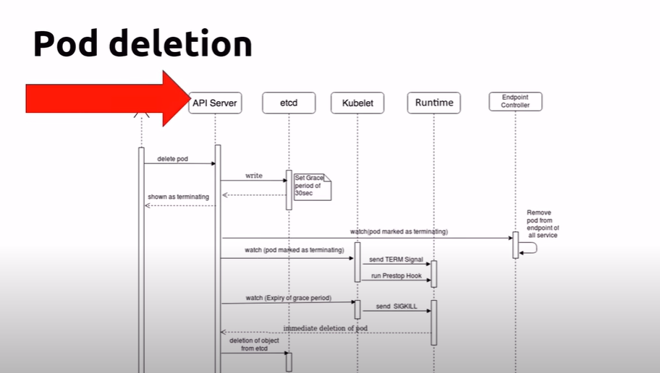
Pods - The Pod Lifecycle
Pod deletion

Slide 57
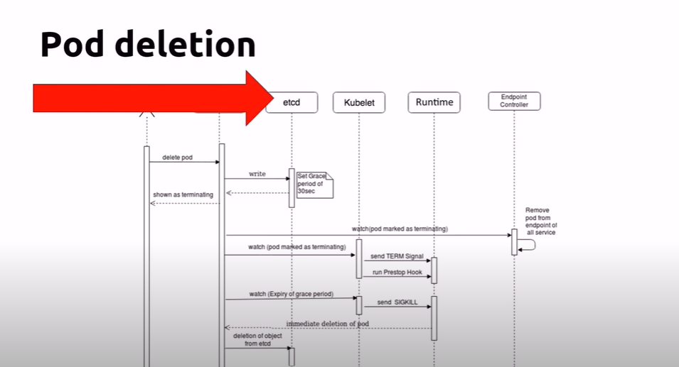
Pods - The Pod Lifecycle
Pod deletion

Slide 58
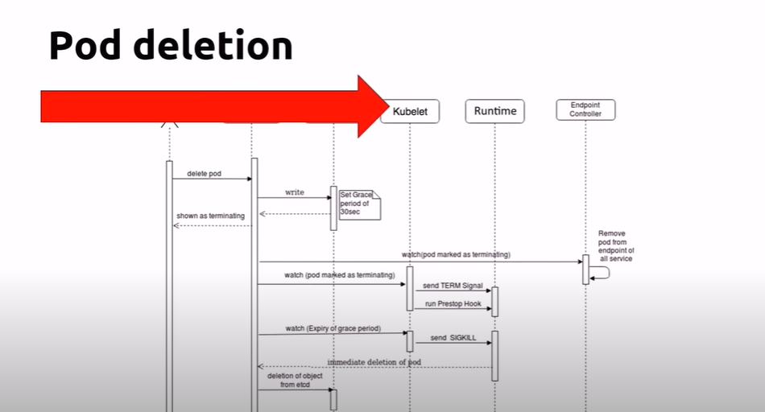
Pods - The Pod Lifecycle
Pod deletion

Slide 59
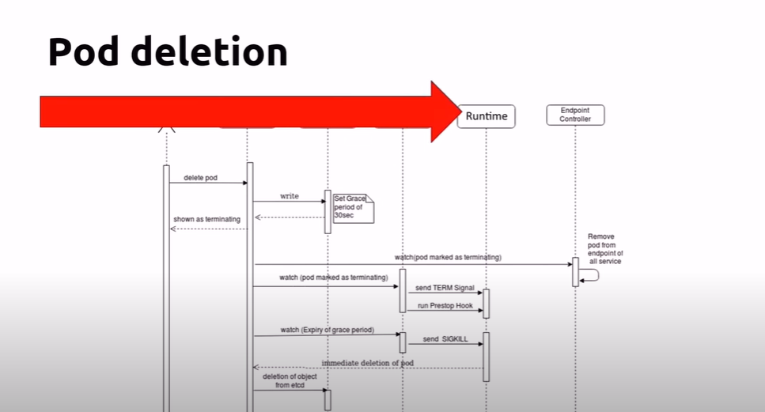
Pods - The Pod Lifecycle
Pod deletion

Slide 60
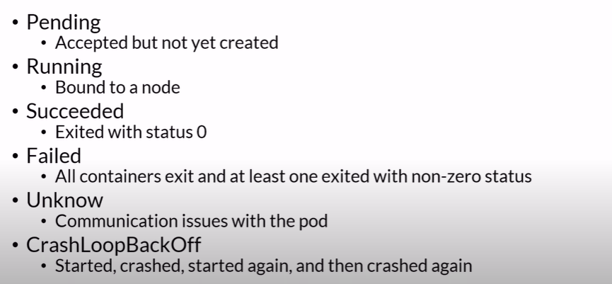
Pods - The Pod Lifecycle
Pod state

Slide 61
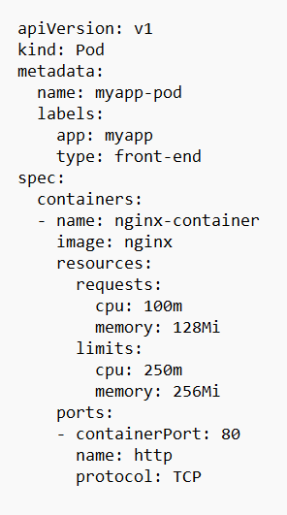
Pods - Defining and Running Pods
YAML

Slide 62
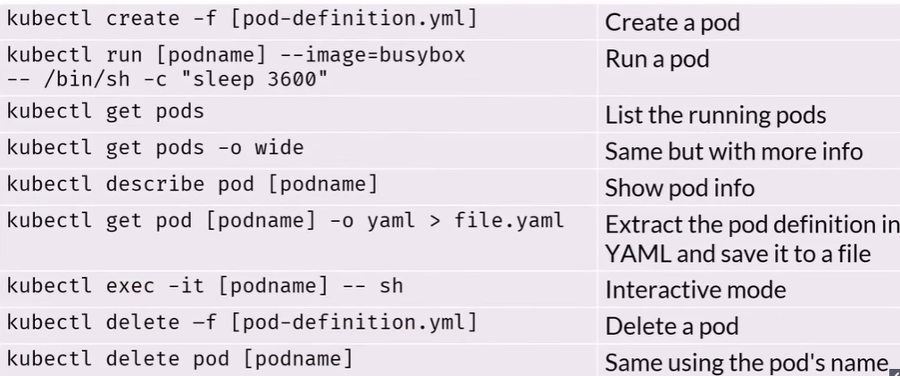
Pods - Defining and Running Pods
Kubectl – Pod Cheat Sheet

Slide 63
Pods - Pod Hands-On

Slide 64
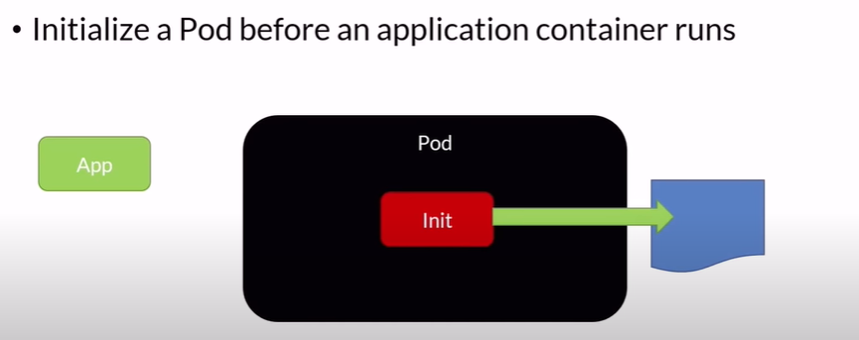
Pods - Init Containers
Init Containers

Slide 65
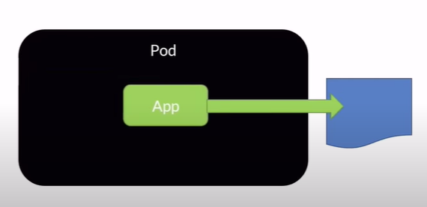
Pods - Init Containers
Init Containers

Slide 66
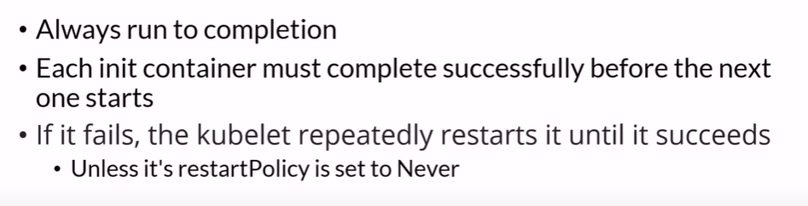
Pods - Init Containers
Init Containers

Slide 67

Selectors - Selector Concepts
Labels:
Key-value pair used to identified, describe and group related sets of objects and resources

Slide 68

Selectors - Selector Concepts
Selectors:
Selectors use labels to filter or select objects

Slide 69
Selectors - Selector Hands-On

Slide 70

Multi Container Pods
Most common scenario: Helper process

Slide 71

Multi Container Pods

Slide 72

Multi Container Pods

Slide 73

Multi Container Pods
Kubectl – Pod Cheat Sheet

Slide 74
Multi Container Pods - Multi Containers Pods Hands-On

Slide 75

Networking Concepts

Slide 76

Networking Concepts

Slide 77

Networking Concepts

Slide 78

Networking Concepts

Slide 79

Networking Concepts

Slide 80

Networking Concepts

Slide 81

Networking Concepts

Slide 82

Workloads
Workloads

Slide 83

Workloads - ReplicaSet Concepts
ReplicaSet

Slide 84

Workloads - ReplicaSet Concepts
ReplicaSet

Slide 85

Workloads - ReplicaSet Concepts

Slide 86

Workloads - ReplicaSet Concepts

Slide 87

Workloads - ReplicaSet Concepts

Slide 88

Workloads - ReplicaSet Concepts
Kubectl – ReplicaSets Cheat Sheet

Slide 89
Workloads - ReplicaSet Hands-On

Slide 90

Workloads - Deployment Concepts
Pods vs Deployments

Slide 91

Workloads - Deployment Concepts

Slide 92

Workloads - Deployment Concepts

Slide 93

Workloads - Deployment Concepts

Slide 94

Workloads - Deployment Concepts

Slide 95

Workloads - Deployment Concepts

Slide 96

Workloads - Deployment Concepts
Kubectl – Deployments Cheat Sheets

Slide 97
Workloads - Deployment Hands-On

Slide 98

Workloads - DaemonSet Concepts
Workloads

Slide 99

Workloads - DaemonSet Concepts

Slide 100

Workloads - DaemonSet Concepts

Slide 101

Workloads - DaemonSet Concepts
Kubectl – DaemonSet Cheat Sheet

Slide 102
Workloads - DaemonSet Hands-On

Slide 103

Workloads - Job Concepts
Job

Slide 104

Workloads - Job Concepts

Slide 105

Workloads - Job Concepts
Kubectl – Job Cheat Sheet

Slide 106
Workloads - Job Hands-On

Slide 107

Workloads - CronJob Concepts
CronJob

Slide 108

Workloads - CronJob Concepts

Slide 109

Workloads - CronJob Concepts

Slide 110

Workloads - CronJob Concepts

Slide 111
Workloads - CronJob Hands-On

Slide 112

Updates - Rolling Updates Concepts

Slide 113

Updates - Rolling Updates Concepts

Slide 114

Updates - Rolling Updates Concepts
RollingUpdate

Slide 115

Updates - Rolling Updates Concepts
Kubectl – Rolling Updates Cheat Sheet

Slide 116
Updates - Rolling Updates Hands-On

Slide 117

Services -What are services?

Slide 118

Services -What are services?

Slide 119

Services -What are services?
Services

Slide 120

Services -What are services?

Slide 121

Services -What are services?

Slide 122

Services - ClusterIP Concepts

Slide 123

Services - ClusterIP Concepts
Kubectl – ClusterIP Cheat Sheet

Slide 124
Services - ClusterIP Hands-On

Slide 125

Services - NodePort Concepts

Slide 126

Services - NodePort Concepts
nodePort

Slide 127

Services - NodePort Concepts

Slide 128

Services - NodePort Concepts

Slide 129
Services - NodePort Hands-On

Slide 130
Storage & Persistence Concepts

Slide 131

Storage & Persistence Concepts

Slide 132

Storage & Persistence Concepts
Persistent Volumes and Claims

Slide 133

Storage & Persistence – The Static Way

Slide 134

Storage & Persistence – The Static Way

Slide 135

Storage & Persistence – The Static Way
Reclaim Policies

Slide 136

Storage & Persistence – The Static Way
Access modes

Slide 137

Storage & Persistence – The Static Way

Slide 138

Storage & Persistence – The Static Way

Slide 139

Storage & Persistence – The Static Way
Persistent volume states

Slide 140

Storage & Persistence – The Static Way
Kubectl – PV and PVC Cheat Sheet

Slide 141
Storage & Persistence – The Static Way Hands-On

Slide 142

Storage & Persistence – The Dynamic Way
StorageClass

Slide 143

Storage & Persistence – The Dynamic Way

Slide 144

Storage & Persistence – The Dynamic Way
Reclaim policy

Slide 145

Storage & Persistence – The Dynamic Way
Access modes

Slide 146

Storage & Persistence – The Dynamic Way

Slide 147

Storage & Persistence – The Dynamic Way

Slide 148

Storage & Persistence – The Dynamic Way

Slide 149

Storage & Persistence – The Dynamic Way

Slide 150

Storage & Persistence – The Dynamic Way
Kubectl – StorageClass Cheat Sheet

Slide 151

Application Settings - ConfigMaps
ConfigMaps

Slide 152

Application Settings - ConfigMaps

Slide 153

Application Settings - ConfigMaps

Slide 154

Application Settings - ConfigMaps
Kubectl – ConfigMaps Cheat Sheet

Slide 155
Application Settings - ConfigMaps Hands-On

Slide 156

Application Settings - Secrets
Secrets Type

Slide 157

Application Settings - Secrets
Secrets

Slide 158

Application Settings - Secrets
Secrets

Slide 159

Application Settings - Secrets

Slide 160

Application Settings - Secrets
Kubectl – Secrets Cheat Sheet

Slide 161
Application Settings - Secrets Hands-On

